Slide 1

ALGORITHMS VISUALIZER
Nandini Vadlamudi
Sri Chetan Vallabhaneni
Kirankumar Vasala
Divya Vipparla
Purnachandra Manepalli
Sravya Mudiraj Ambati
Anvika Muthineni

Slide 2

Abstract
Over the years it is known that algorithms being a complex subject is the foundation of computational thinking and programming skills. So, to ease up the hardships of students this idea of the project was formed.
Visualgo is an Algorithm Visualizer which is both interactive and alluring. It gives the users hands on experience of the algorithms' implementation. It feeds into their imagination to help them get a better understanding. This interface is designed to make one feel fully engaged and concentrated and uses Java as primary language.
The purpose of this project is to make learning less of a burden and more of an incredible experience which leaves users with the want to learn more.

Slide 3

INTRODUCTION
Algorithm visualizer is a powerful tool that allows programmers to visualize and understand algorithms in a more intuitive way.
It provides an interactive platform for experimenting with different algorithms and data structures, allowing users to see how they work in real-time.
With algorithm visualizer, users can gain a deeper understanding of complex algorithms by seeing them in action.
This can help programmers to identify potential bottlenecks and optimize their code for better performance.

Slide 4
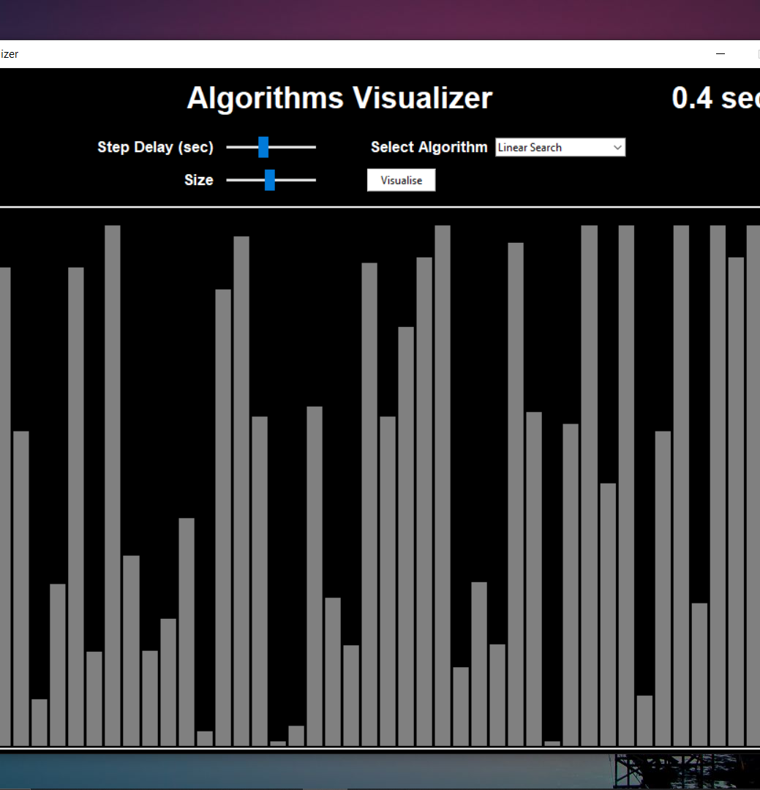
Features Of Algorithm Visualizer
Algorithm visualizer comes with a range of features that make it a powerful tool for programmers. One of its key features is the ability to visualize different algorithms and data structures in real-time, allowing users to see how they work and how they can be optimized.
Another important feature of algorithm visualizer is its interactivity. Users can experiment with different parameters and inputs to see how they affect the output of the algorithm. This allows programmers to fine-tune their code and optimize it for better performance.

Slide 5
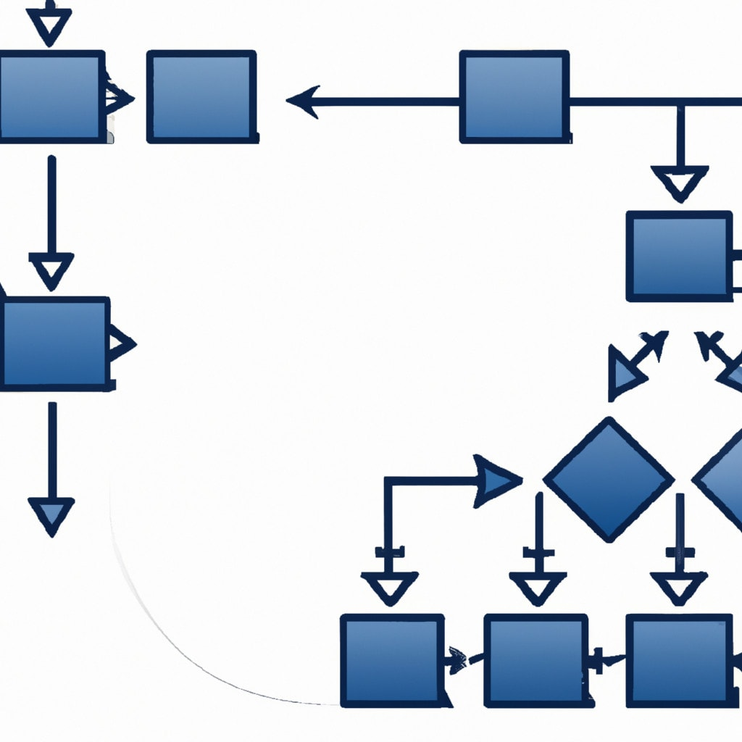
Advantages
One of the main benefits of algorithm visualizer is that it allows programmers to gain a deeper understanding of complex algorithms. By seeing these algorithms in action, users can better understand how they work and how they can be optimized.
Algorithm visualizer can also help programmers to identify potential bottlenecks in their code.
By experimenting with different inputs and parameters, users can see how these affect the performance of the algorithm and identify areas where improvements can be made.

Slide 6

Real-World Applications
Algorithm visualizer has a wide range of applications in the real world. For example, it can be used to optimize algorithms used in finance, such as those used for stock trading or risk analysis.
Algorithm visualizer can also be used in scientific research, such as in the analysis of large datasets or simulations.
By visualizing complex algorithms, researchers can gain a better understanding of the underlying processes and make more accurate predictions.

Slide 7

Contents
Algorithms that are included in the project are:
Sorting Algorithms
Linear Search:
Linear Search is defined as a sequential search algorithm that starts at one end and goes through each element of a list until the desired element is found, otherwise the search continues till the end of the data set.
Binary Search:
Binary Search is defined as a searching algorithm used in a sorted array by repeatedly dividing the search interval in half. The idea of binary search is to use the information that the array is sorted and reduce the time complexity to O(log N).

Slide 8
Sorting Algorithms
Bubble Sort:
Bubble Sort is the simplest sorting algorithm that works by repeatedly swapping the adjacent elements if they are in the wrong order. This algorithm is not suitable for large data sets as its average and worst-case time complexity is quite high.
Selection Sort
Selection sort is a simple and efficient sorting algorithm that works by repeatedly selecting the smallest (or largest) element from the unsorted portion of the list and moving it to the sorted portion of the list.
Insertion Sort
Insertion sort is a simple sorting algorithm that works similar to the way you sort playing cards in your hands. The array is virtually split into a sorted and an unsorted part. Values from the unsorted part are picked and placed at the correct position in the sorted part.

Slide 9
Contents contd..
Quick Sort
Quick Sort is a sorting algorithm based on the Divide and Conquer algorithm that picks an element as a pivot and partitions the given array around the picked pivot by placing the pivot in its correct position in the sorted array.
Heap Sort
Heap sort is a comparison-based sorting technique based on Binary Heap data structure. It is similar to the selection sort where we first find the minimum element and place the minimum element at the beginning. Repeat the same process for the remaining elements.
Merge Sort
Merge sort is defined as a sorting algorithm that works by dividing an array into smaller subarrays, sorting each subarray, and then merging the sorted subarrays back together to form the final sorted array.

Slide 10

Path Finder Algorithms
PathFinder Algorithm
Path finding algorithms build on top of graph search algorithms and explore routes between nodes, starting at one node and traversing through relationships until the destination has been reached. These algorithms find the cheapest path in terms of the number of hops or weight. Weights can be anything measured, such as time, distance, capacity, or cost.
- We have implemented Dijkstra’s algorithm, BFS and DFS in path finder for shortest route from source to destination.

Slide 11
BackTracking
N Queen Algorithm
The N Queen is the problem of placing N chess queens on an N×N chessboard so that no two queens attack each other.
SolveNQueensUtil(): Returns true if the queens don’t attack each other and satisfies the following condition:
The queens should not be in:
1. Same row
2. Same Column
3. Diagonal to each other
Else returns false and displays the solution.
DrawBoard(): This function is used to draw the initial board or the maze. A size of N*N matrix is passed to this function to draw the board.

Slide 12

Limitations
While algorithm visualizer is a powerful tool, it does have some limitations. One of the main limitations is that it can be difficult to represent certain types of algorithms visually, particularly those that involve complex data structures or multiple threads.
Another limitation of algorithm visualizer is that it can be resource-intensive, particularly when dealing with large datasets or complex algorithms. This can make it impractical for use in some applications.

Slide 13
Conclusion
In conclusion, algorithm visualizer is a powerful tool that allows programmers to gain a deeper understanding of complex algorithms. Its ability to provide real-time visualization and interactivity makes it a valuable asset for optimizing code and identifying potential bottlenecks.
While it does have some limitations, algorithm visualizer has a wide range of applications in the real world and can be used in many different fields, from finance to scientific research.

Slide 14
THANK YOU

